Slide 1

The Independent-Samples t Test
Chapter 11

Slide 2
Quick Test Reminder
One person = Z score
One sample with population standard deviation = Z test
One sample no population standard deviation = single t-test
One sample test twice = paired samples t

Slide 3
Independent Samples t-Test
Used to compare two means in a between-groups design (i.e., each participant is in only one condition)
Remember that dependent t (paired samples) is a repeated measures or within-groups design

Slide 4

Did you notice?
More about beer!

Slide 5
Between groups design
In between groups, your sets of participant’s scores (i.e. group 1 versus group 2) have to be independent
Remember independence is the assumption that my scores are completely unrelated to your scores

Slide 6
Quick Distributions Reminder
Z = Distribution of scores
Z = distribution of means (for samples)
t = distribution of means (for samples with estimated standard deviation)
t = distribution of differences between paired scores (for paired samples with estimated standard deviation)
t = distribution of differences between means (for two groups independent t)

Slide 7
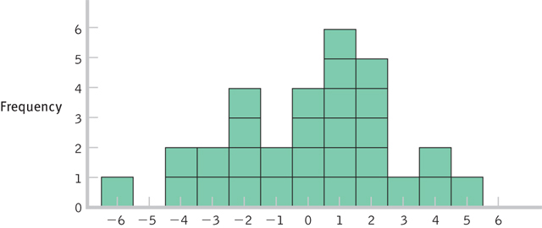
Distribution of Differences Between Means

Slide 8
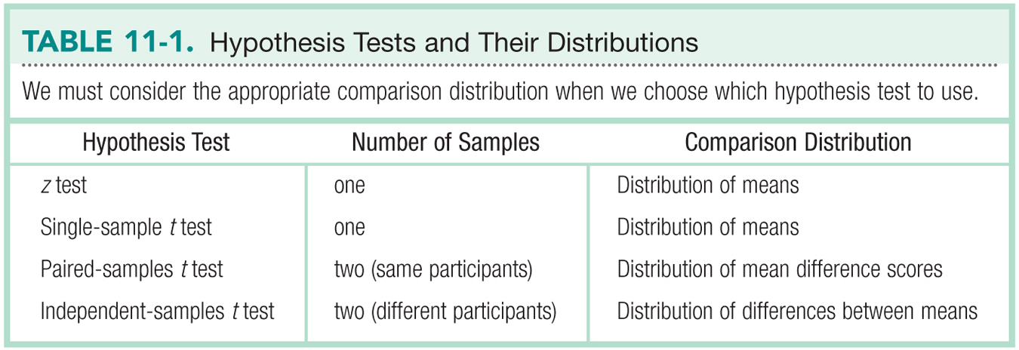
Hypothesis Tests & Distributions

Slide 9
Let’s talk about Standard Deviation
Test | Standard Deviation | Standard deviation of distribution of … (standard error)
Z | σ (population) | σ_{M}
Single t | s (sample) | s_{M}
Paired t | s (sample on difference scores) | s_{M}
Independent t | s group 1 s group 2 s_{pooled} | s_{difference}

Slide 10
Let’s talk about Standard Deviation
Variance = same for all tests, but paired t is on difference scores
Standard error = same for paired and single t
Take the square root for standard deviation of these

Slide 11
Let’s talk about Standard Deviation
Variance = same for all tests, but paired t is on difference scores
This section is for independent t only
Take the square root for standard deviation of these

Slide 12
Let’s talk about test statistics
Test type | Formula
Z | M – μ_{M} σ_{M}
Single t | M – μ_{M} s_{M}
Paired t | M s_{M}
Independent t | M – M s_{difference}

Slide 13
Additional Formulae

Slide 14
Let’s talk about df
Test type | df
Single sample | N – 1
Paired samples t | N – 1
Independent t | N – 1 + N – 1

Slide 15
Assumptions
Assumption | Solution
Normal distribution | N >=30
DV is scale | Nothing – do nonparametrics
Random selection (sampling) | Random assignment to group

Slide 16
Steps for Calculating Independent Sample t Tests
Step 1: Identify the populations, distribution, and assumptions.
Step 2: State the null and research hypotheses.
Step 3: Determine the characteristics of the comparison distribution.
Step 4: Determine critical values, or cutoffs.
Step 5: Calculate the test statistic.
Step 6: Make a decision.

Slide 17
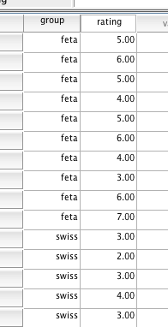
SPSS
You’ll need two columns:
Group membership column (independent variable)
Remember use value labels! Helps with reading the output
Dependent variable column

Slide 18
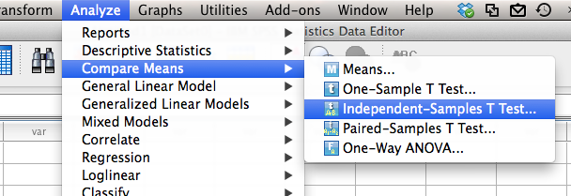
SPSS
Analyze > compare means > Independent Samples T-Test

Slide 19
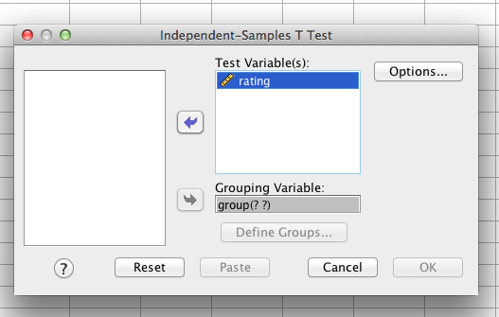
SPSS
IV goes in grouping variable, DV into Test variable

Slide 20
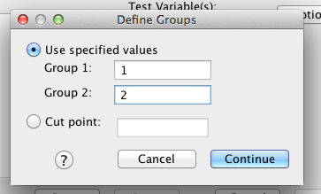
SPSS
Hit define groups. Put in the numbers that you used to define groups

Slide 21
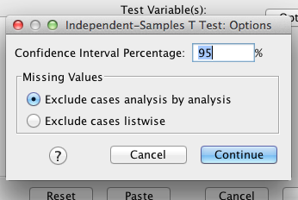
SPSS
Hit options – if you need a 99% CI, you can change it here.

Slide 22
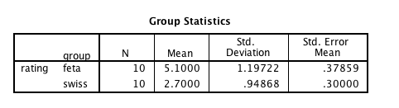
SPSS
N values for each group
M values for each group
s values for each group
s_{M} values for each group (not the standard error you need)
(Confidence intervals here)

Slide 23
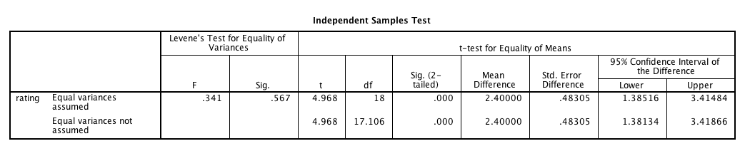
SPSS
t = step 5
df = step ¾
Mdifference = M – M
Std. Error = Sdifference
CI = CI around Mdifference (what the book suggests)

Slide 24
Reporting the Statistics
t(df) = tcalc, p < .05
Use p > .05 if there is no difference between means
Use p < .05 if there is a difference between means
t(7) = -2.44, p < .05

Slide 25
Beyond Hypothesis Testing
Just like z tests, single-sample t tests, and paired-samples t tests, we can calculated confidence intervals and effect size for independent-samples t tests

Slide 26
Steps for Calculating CIs
The suggestion for CI for independent t is to calculate the CI around the mean difference (M – M).
This calculation will tell you if you should reject the null.
Does not match what people normally do (which is calculate each M CI separately).

Slide 27
Effect Size
Used to supplement hypothesis testing
Cohen’s d:

